Slide 1
GUI Programming, Part 2
Dialogs

Slide 2
Outline
JOptionPane Dialogs
FileDialog class
  file reading into JTextArea (using BufferedReader)
  file saving (using PrintWriter)

Slide 3
Dialogs
A (J)Dialog is a way of obtaining user responses. This may be as simple as “OK”, “YES/ NO”, but may be more complex.
Construction of Dialog is very similar to that of Frame
Two important parameters to consider
  owner
    place from which the dialog is displayed
  modal
    Set it true, so no other user response is allowed within the application until the dialog is dealt with
    Set it false, so user is free to continue with the application and respond to the dialog at some later stage
Everything depends on the frame, if the frame destroyed, dialog destroys!
Notes:
A dialog window is an independent window which tries to notify user of something and obtain user response apart from the main window.
Most dialogs presents warnings, error messages to the user but it can be more than that.

Slide 4
JOptionPane
We use JOptionPane to quickly create and customise several different types of dialogs.
It provides support for;
  Laying out standard dialogs,
  Provide icons,
  Specify dialog text and title,
  Customise the button text,
  Where the dialog should appear on the screen etc.
Notes:
When you use JOptionPane to implement a dialog, you're still using a JDialog behind the scenes. JOptionPane is simply a container that can automatically create a JDialog and add itself to the JDialog's content pane.

Slide 5
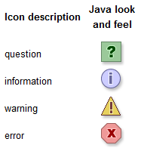
JOptionPane
JOptionPane has static methods to create & use simple dialogs
Common parameters for the 4 types of dialogs
Four types of dialogs
Method Name | Description
showConfirmDialog | Asks a confirming question, like yes/no/cancel.
showInputDialog | Prompt for some input.
showMessageDialog | Tell the user about something that has happened.
showOptionDialog | The Grand Unification of the above three.
ParentComponent
Message
OptionType
  DEFAULT_OPTION
  YES_NO_OPTION
  YES_NO_CANCEL_OPTION
  OK_CANCEL_OPTION
MessageType
  ERROR_MESSAGE
  INFORMATION_MESSAGE
  WARNING_MESSAGE
  QUESTION_MESSAGE
  PLAIN_MESSAGE
[From the Java’s API]
Notes:
Message Type: Defines the style of the message.
Option Type: Defines the set of option buttons that will appear at the bottom of the dialog box.
Options: The usual value for the options parameter is an array of Strings. But the parameter type is an array of Objects. A button is created for each object depending on its type:
Direct Use:
To create and use an JOptionPane directly, the standard pattern is roughly as follows:
JOptionPane pane = new JOptionPane(arguments);
pane.set.Xxxx(...); // Configure
JDialog dialog = pane.createDialog(parentComponent, title);

Slide 6
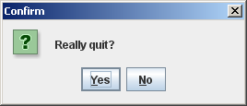
JOptionPane - showConfirmDialog
  int choice = JOptionPane.showConfirmDialog(
  this,
"Really quit?",
"Confirm",
JOptionPane.YES_NO_OPTION,
JOptionPane.QUESTION_MESSAGE);
if (choice == JOptionPane.YES_OPTION)
{
System.exit(0);
}
Parent Component
Message
Message Title
Option Type
Message Type

Slide 7
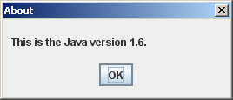
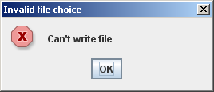
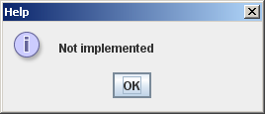
JOptionPane - showMessageDialogs
JOptionPane.showMessageDialog(
this,
“This is the Java version 1.6.",
"About",
JOptionPane.PLAIN_MESSAGE );
frame
Message
Title
Message Type
JOptionPane.showMessageDialog( this,
"Can't write file ",
"Invalid file choice",
JOptionPane.ERROR_MESSAGE );
JOptionPane.showMessageDialog(this,
"Not implemented ",
"Help", JOptionPane.INFORMATION_MESSAGE );

Slide 8
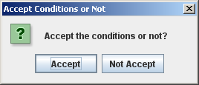
JOptionPane - showOptionDialog
Object[] options = { "Accept", "Not Accept" };
JOptionPane.showOptionDialog(this,
"Accept the conditions or not?",
"Accept Conditions or Not",
JOptionPane.DEFAULT_OPTION,
JOptionPane.QUESTION_MESSAGE,
null,
options,
options[0]);
Message
Title
Option Type
Message Type
Don’t use a custom icon
Titles of the option buttons
Default Option

Slide 9
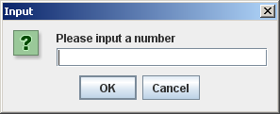
JOptionPane - showInputDialog
int num = Integer.parseInt(
JOptionPane.showInputDialog("Please input a number"));
Only form of dialog box that will not return an integer

Slide 10
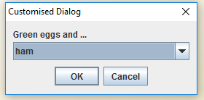
JOptionPane - showInputDialog
A much complex one!!
Options:
ham
yam
spam
Object[] possibilities = {"ham", "yam", "spam"};
JOptionPane.showInputDialog(frame, "Green eggs and ...", "Customised Dialog", JOptionPane.PLAIN_MESSAGE, null, possibilities, "ham");
Notes:
Object[] possibilities = {"ham", "yam", "spam"};
JOptionPane.showInputDialog(frame, "Green eggs and ...", "Customised Dialog", JOptionPane.PLAIN_MESSAGE, null, possibilities, "ham");

Slide 11
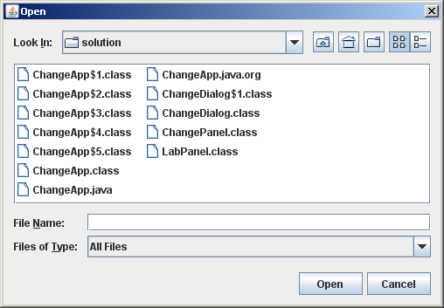
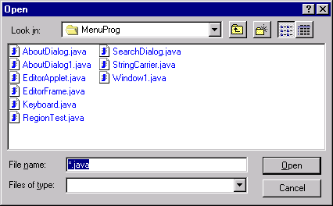
Dialogs for Opening a File
JFileChooser (Swing)
  JFileChooser chooser = new JFileChooser();
  chooser.showOpenDialog(this);
  File f = chooser.getSelectedFile();
  String fileName = f.getName()
FileDialog (AWT)
  FileDialog openFileDialog = new FileDialog(this, "Open", FileDialog.LOAD);
  String fileName = openFileDialog.getDirectory() + openFileDialog.getFile();
Notes:
JFileChooser and FileDialog provides a GUI for navigating the file system.
They provide a modal dialog to choose a file by blocking the rest of the application until the user choses an action.

Slide 12
Dialogs for Saving a File
JFileChooser
  JFileChooser chooser = new JFileChooser();
  chooser.showSaveDialog(this);
  File f = chooser.getSelectedFile();
  String fileName = f.getName()
FileDialog
  FileDialog saveFileDialog = new FileDialog(this, “Save", FileDialog.SAVE);
  String fileName = saveFileDialog.getDirectory() + saveFileDialog.getFile();

Slide 13
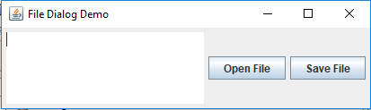
Example – File Opening and Saving
public class EditorFrame extends JFrame
{
private JTextArea editTextArea;
private JButton openButton;
private JButton saveButton;
private FileDialog openFileDialog;
private FileDialog saveFileDialog;
private String fileName = "Unknown";
public EditorFrame()
{
super("File Dialog Demo");
makeFrame(); //next slide
openFileDialog = new FileDialog(this, "Open", FileDialog.LOAD);
openFileDialog.setFile("*.txt");
saveFileDialog = new FileDialog(this, "Save", FileDialog.SAVE);
}
EditorFrame object

Slide 14
public void makeFrame()
{
Container contentPane = getContentPane();
editTextArea = new JTextArea(5,20);
openButton = new JButton("Open File");
openButton.addActionListener(
new ActionListener() {
public void actionPerformed(ActionEvent e) {
openItemAction();
}
}
);
saveButton = new JButton("Save File");
saveButton.addActionListener(
new ActionListener() {
public void actionPerformed(ActionEvent e) {
saveItemAction();
}
}
);
setLayout(new FlowLayout());
setSize(400,400);
contentPane.add(editTextArea);
contentPane.add(openButton);
contentPane.add(saveButton);
pack();
setVisible(true);
}

Slide 15
Example – File Opening and Saving (continued)
//This method is invoked by the actionPerformed() of the openButton
private void openItemAction()
{
openFileDialog.setVisible(true);
fileName = openFileDialog.getDirectory() +
openFileDialog.getFile();
String s = readFile(fileName); //next slide
editTextArea.setText(s);
}
FileDialog
appears
User must have closed the dialog to reach here
If Cancel is clicked, getFile() and getDirectory() will return null
Notes:
If Cancel is clicked then both of these queries return null.
If the code were excatly as written then readFile would have the parameter "nullnull" which is not a likely to name a file that exists -- hence FileNotFoundException.
What is needed is an if-statement, like
if (openFileDialog.getFile != null)
{
. . .

Slide 16
Example – File Opening and Saving (continued)
private String readFile(String fileName)
{
String s = "";
try
{
BufferedReader br = new BufferedReader(new FileReader(fileName));
String line = br.readLine();
while(line != null)
{
s += line + "\n";
line = br.readLine();
}
br.close();
}
catch(FileNotFoundException e){
s = "Failed to find file: " + fileName;
}
catch (IOException e) {
s = "Failed to read file: " + fileName;
}
return s;
}
Notes:
A FileReader class is a general tool to read in characters from a File. The BufferedReader class can wrap around Readers, like FileReader, to buffer the input and improve efficiency. So you wouldn't use one over the other, but both at the same time by passing the FileReader object to the BufferedReader constructor.
Buffering streams - Now file buffering is faster than file stream reading. It's the same concept as you see on youtube. youtube buffers some amount of video before it actually starts playing it, so you can have flawless video watching experience.
So the file buffering uses BufferedReader object instance, and you need to specify which stream you want to buffer, in this case it's a file so you need to pass a FileReader object.
BufferedReader br = new BufferedReader( new FileReader("example.txt") ); now here, bufferedReader buffers the file means it keeps reading a file one by one character, until it hits '\n', '\r\n' (new line) character and stores fetched characters into a string (in short fetches the lines and stores it into buffer).

Slide 17
Example – File Opening and Saving (continued)
//This method is invoked by the actionPerformed() of saveButton
private void saveItemAction()
{
if (fileName.equals("Unknown"))
saveAsItemAction();
else
fileSave(fileName, editTextArea.getText()); //next slide
}
FileDialog
appears, so the user has to confirm the file name provided, or change the file name there.
private void saveAsItemAction()
{
aveFileDialog.setVisible(true);
fileName = saveFileDialog.getDirectory() + saveFileDialog.getFile();
fileSave(fileName, editTextArea.getText()); //next slide
}
User must have closed the dialog to reach here

Slide 18
Example – File Opening and Saving (continued)
private void fileSave(String fileName, String data)
{
PrintWriter outputStream = null;
try
{
outputStream = new PrintWriter(new FileWriter(fileName));
String [] lines = data.split("\n");
for(int i = 0; i < lines.length; i++)
{
outputStream.println(lines[i]);
}
outputStream.close( );
}
catch(FileNotFoundException e)
{
System.out.println("Error opening the file "
+ fileName);
System.exit(0);
}
catch(IOException e)
{
System.out.println("Error writing to the file "
+ fileName);
System.exit(0);
}
}
Notes:
Characters will be stored as bytes in files.
outputStream.println(lines[i]) - Prints a String and then terminates the line.

Slide 19
Reference
Java tutorial
Java API

